Slide 1
COVID-19
Florida National High Adventure Sea Base

Slide 2
Response Authorities
Center for Disease Control
Florida Department of Health
Monroe County Department of Health
Monroe County BOCC
Local EMS
US Virgin Islands Health Department.

Slide 3
Sea Base Statement
To date, Sea Base had no confirmed cases of COVID-19. This, in large part, is due to participants, staff, and captains taking proactive precautions and the risk seriously.
Sea Base is now operating at full capacity in accordance with our COVID-19 Mitigation Plan and local and state authorities. This plan includes changes to program and facility operations, sanitation, housing, food service, and staffing.

Slide 4
IMPORTANT NOTE
Precautions cannot fully eliminate the potential for exposure to COVID-19 or any other illness while at Sea Base. Persons with COVID-19 may show no signs or symptoms of illness, but can still spread the virus, and people may be contagious before their symptoms occur. It is possible that someone with COVID-19 may pass the required health screenings and be allowed into camp.
Every staff member, volunteer, and Scouting family must evaluate their unique circumstances and make an informed decision before choosing to attend Sea Base.

Slide 5
Pre-Trek Planning & Unit Screening
Cohorts and Social Distancing: Due to the nature of Sea Base programs, participants within a crew cannot be expected to socially distance from one another. As a result, each crew will be treated as a cohort. Cohorts will not be permitted to interact with other cohorts or unassigned staff members.
Know Before You Go: Units traveling from areas experiencing community spread, at the time of their scheduled arrival, are not eligible to attend Sea Base. Impacted units will be contacted by Sea Base.
Required Unit Screening: Crews must set a date, 1-2 days prior to travel, to complete the required Sea Base Pre-Event Medical Screening Checklist. The document must be submitted upon arrival.

Slide 6
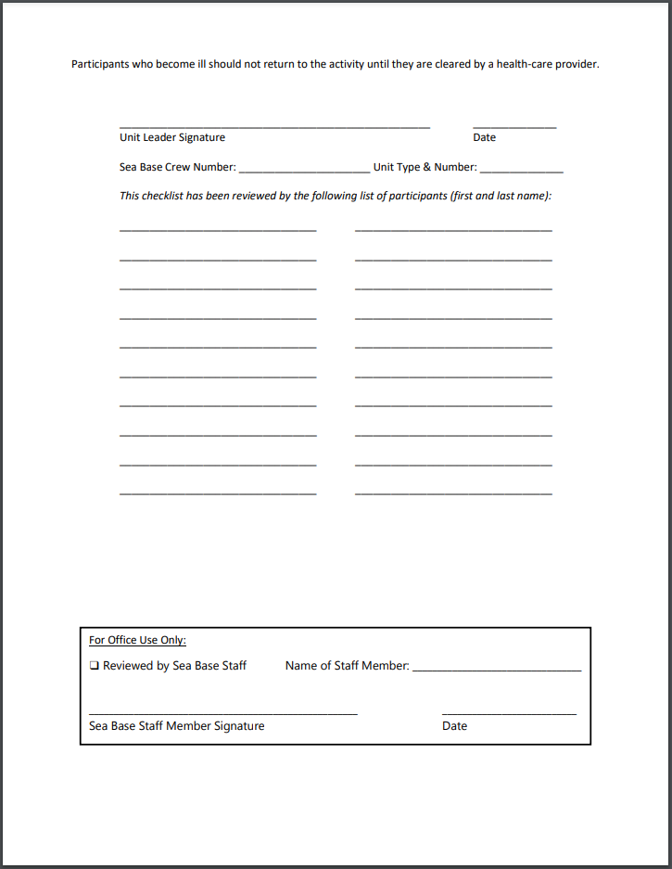
Pre-Trek Planning & Unit Screening

Slide 7
Pre-Trek Planning & Unit Screening
Illness Restrictions: Sick individuals are not eligible to attend Sea Base.
Temperature Restrictions: Individuals with elevated temperatures, above 100.4, are not eligible to attend Sea Base.
Illness/Temperature Restrictions Impacting Crews: Units arriving with (1) or more participants who are sick or have an elevated temperature will be sent to a physician for treatment/testing. If (1) or more members of the crew test positive for a communicable illness/disease, including COVID-19, the crew will not be permitted to remain onsite.

Slide 8
Pre-Trek Planning & Unit Screening
Chronic Medical Conditions: Individuals with serious, chronic, medical conditions should seek medical advice from their physician prior to attending Sea Base.
Scuba Participants Who Have Tested Positive for COVID-19 in the Past: Individuals who have tested positive for COVID-19 or suspect that they contracted COVID-19 at any time should seek the medical advice of their physician and Divers Alert Network prior to attending.
Travel Restrictions: Participants who have traveled outside of the continental United States in the last 1-14 days are not eligible to attend Sea Base unless they have been tested for and cleared of COVID-19.

Slide 9
Pre-Trek Planning & Unit Screening
Exposure Restrictions: Participants who have been exposed to COVID-19 in the last 1-14 days are not eligible to attend Sea Base unless they have been tested for and cleared of COVID-19.
Pre-Trek Social Distancing: Crews must communicate to participants that they should ensure proper distancing between participants and others, other than immediate family members, 2 weeks prior to attending Sea Base whenever possible.
Pre-Trek Social Distancing: Crews must communicate to participants and parents that they should require immediate family members to socially distance 2 weeks prior to their family members arrival at Sea Base whenever possible.

Slide 10
Pre-Trek Planning & Unit Screening
Hand Sanitizer Requirement: Crews must purchase or require each participant to purchase sufficient hand sanitizer to last the duration of the trip to and from Sea Base.
Facial Covering Requirement: Crews must purchase or require each person to purchase a facial covering. Sea Base recommends a “Buff” or “Gaiter” style facial covering like those available at Sea Base Ship Store. Facial coverings must be worn anytime a crew is in common areas where they might encounter individuals from other crews or unassigned staff members, food service areas, retail stores, check-in, aboard vessels with other crews.

Slide 11
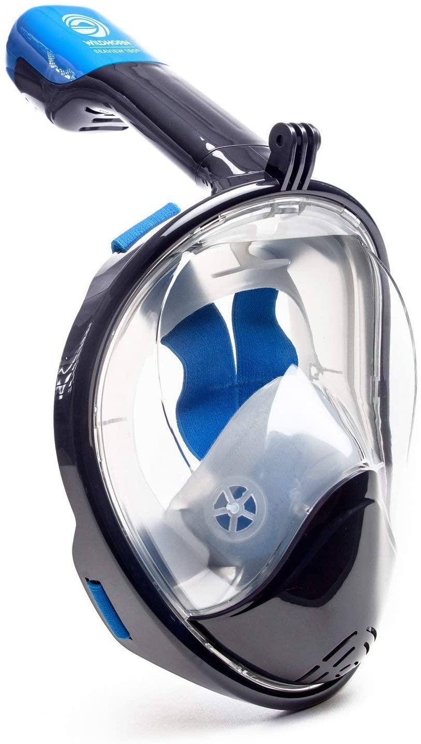
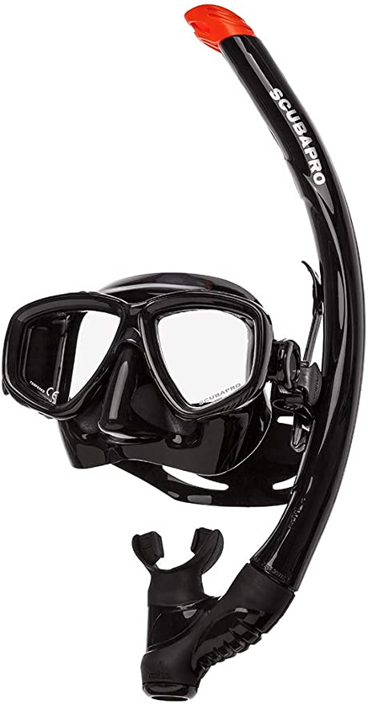
Pre-Trek Planning & Unit Screening
Snorkel & Mask Requirement: Due to COVID-19, Sea Base will no longer provide masks and snorkels. Crews must purchase or require each participant to purchase a snorkel and mask. Sea Base recommends that individuals purchase quality masks and snorkels as “inexpensive” masks and snorkels often leak, fit poorly or break. Quality, discounted, masks and snorkels are available at Sea Base Ship Store.
Due to health & safety concerns,
Full face masks are not permitted at any Sea Base Location

Slide 12
Pre-Trek Planning & Unit Screening
Unit Leadership: Each crew must elect/assign a youth member of your crew to act as the Sanitation Chief for the duration of your adventure. Responsibilities will include:
Instructing/reminding crew members to socially distance from other travelers, other crews, staff members.
Instructing/reminding crew members not to touch their eyes, nose, mouth.
Instructing/reminding crew members to wash hands and use hand sanitizer.
Instructing/reminding crew members to wear facial coverings.
Instructing/reminding crew members to sanitize vessels/dormitories.

Slide 13
Pre-Trek Planning & Unit Screening
Crew Participation Model and Social Distancing: Due to the nature of program types, activities and safety requirements, it is not possible for Sea Base to socially distance within a crew (person to person) or distance the crew from assigned staff members.
Social Distancing Requirements: Crews are required to socially distance from other crews, the public and non-assigned staff members. Crews refusing to socially distance will not be permitted to remain onsite.
Travel Types: Crews should avoid traveling to Sea Base aboard trains or busses unless the provider has social distancing and air purification plans in place.

Slide 14
Traveling to Sea Base
Units traveling to Sea Base should take the following precautions to limit the risk of contracting COVID-19 while traveling to and/from Sea Base:
Sickness: Do not allow participants who are sick to travel.
Exposure: Do not allow participants who have been exposed to COVID-19 to travel.
Handwashing: Wash hands frequently.
Touching: Avoid touching eyes, nose, mouth.
Hand Sanitation: Bring hand sanitizer containing at least 60% alcohol & use frequently.
Facial Covering: Bring and use facial coverings.
Touching: Avoid unnecessary touching of handrails, doors, etc.
Social Distancing: Avoid close contact with non-crew members, within 6ft.
Food Service: Pick up food at drive-throughs, curbside delivery, or stores.
Stops: Limit non-essential stops.
Transportation: Avoid trains and busses unless the provider has social distancing and air purification plans in place.

Slide 15
Checking in at Sea Base
To ensure proper social distancing Sea Base will require:
Facial Covering: Participants must wear facial coverings upon arriving at Sea Base.
Social Distancing: One adult leader will be allowed to check-in his/her crew at a time.
Social Distancing: No other youth or adults from his/her crew, or any other crew, will be permitted in/at the check-in area.
Adult Oversight: Members of each crew will wait in assigned areas. It is the responsibility of the second adult leader to ensure that youth and adults remain in the assigned area.
Medical Screening/Temperature Check: Each participants BSA AHMR will be reviewed, and everyone will have their temperature taken upon arrival. Crews arriving with a sick individual or individual with temperature exceeding 100.4 degrees will not be permitted to remain onsite.

Slide 16
Meal Service
Sea Base will restrict the number of persons who access dining facilities.
USVI Food Service:
St. Thomas crews will eat all meals aboard their vessel.
St. Croix crews will prepare and cook meals in a designated location.
Crews must wear facial coverings when receiving food supplies.
Islamorada Food Service:
Crews will be assigned unit specific mealtimes upon arrival.
No more than one crew may access the main food service area at a time.
Crews will be assigned seating. A minimum of 6ft. will separate each crew.
Crews must wear facial coverings when lining up for meals, walking through the galley and before/after eating.
Brinton Environmental Center Food Service:
Crews will be assigned unit specific mealtimes upon arrival.
No more than one crew may access the main food service area at a time.
Crews will be assigned seating. A minimum of 6ft. will sperate each crew.
Crews must wear facial coverings when lining up for meals, walking through the galley and before/after eating.
Camp Sawyer:
Crews will be assigned mealtime and seating areas.
Crews must wear facial coverings when receiving food supplies.

Slide 17
Meal Service
Sea Base has enacted a sanitation plan for food service areas including front of the house, back of the house, delivery and refuse disposal.
Service Lines: Staff will clean and sanitize service lines between each service.
Food Preparation: Staff will clean and sanitize non-service areas in accordance with Florida Department of Health regulations.
Seating: Staff will clean and sanitize all seating prior to and following each series of services; breakfast, lunch, dinner.

Slide 18
Ship Store
Florida Keys retail locations are limited to:
Islamorada Ship Store: 8 individuals or as specified.
Islamorada Snack Bar: 8 individuals or as specified.
Brinton Environmental Center: individuals or as specified.
Camp Sawyer: 2 individuals.
St. Croix: 2 individuals.

Slide 19
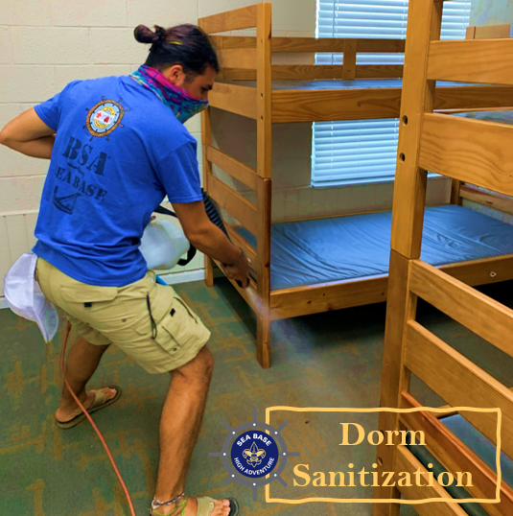
Dormitories
Sea Base has erected walls in dormitories to designate space for individual crews. Unless there is considerable change to COVID-19 restrictions, crews will not share designated dorm space. If there are insufficient dormitories, Sea Base will provide air-conditioned “glamping” tents.
Sea Base will clean and sanitize dormitories & tents between use.

Slide 20
Vessels
Sailing Vessels
No more than one crew may be aboard a sailing vessel at a time.
Captains and crews will clean and sanitize vessels upon crew arrival and before crew departure or as designated upon arrival.
Scuba & Snorkel Vessels
Each vessel will be sectioned creating +6ft distance between crews.
Vessels will be cleaned and sanitized before and following each use.
Crews will be restricted to their designated areas.

Slide 21
Sea Base Camp-Wide Activities
Any activities in which Sea Base cannot ensure social distancing will be restricted to individual crews

Slide 22
Staff Wellness
Sea Base staff and captains will be subject to medical review, mandatory illness reporting and temperature checks.
Staff and captains will attend COVID-19 specific training.
Staff and captains will be required to socially distance from all non-assigned crews.
Staff and captains will be required to socially distance from the public whenever possible and adhere to social distancing when in public.
Staff and captains will be required to wear facial coverings in common areas, retail, food service areas, and whenever prudent/possible aboard vessels.

Slide 23
COVID-19 Surcharge
“Due to the circumstances surrounding COVID-19, the BSA is notifying all registrants scheduled to attend one of the national High-Adventure bases of a one-time COVID-19 surcharge fee of $50 per participant. This fee will offset the additional costs associated with operating High-Adventure Bases in accordance with CDC, state and local guidelines and precautionary measures intended to keep all participants safe.
This surcharge is necessary because the additional expenses associated with addressing COVID-19 were not accounted for when the 2021 High-Adventure Base fees were set 12-18 months ago.”

Slide 24
General Personal Cleanliness
Sea Base participants, staff and captains are required to:
Frequently wash hands for 30 seconds using soap and water.
Avoid touching their mouth, nose, eyes.
Possess and use hand sanitizer containing 60% alcohol.
Possess and wear facial coverings

Slide 25
Closing
Sea Base has developed a plan to decrease the likelihood of COVID-19 transmission. Sea Base has shared its plan with local health officials. Staff and captains have and will continue to receive significant training. However, no level of planning can fully eliminate the potential for COVID-19 transmission. Traveling to, participating at, and returning home from Sea Base presents risk.
It is essential that each participant, parent or guardian, and volunteer adult leader understands the risks associated prior to attending Sea Base. Ultimately it is the responsibility of attendees and their parents or guardians to make the decision that is best for them and their families.

