Slide 1
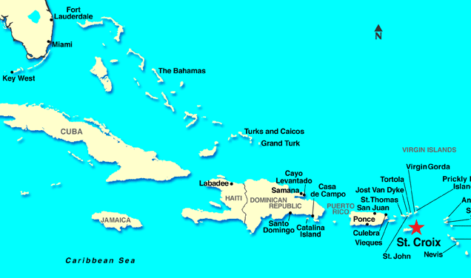
St. Croix
SCUBA Adventure Program

Slide 2
Arrival and Registration
Arrival Time is between 1 and 3 PM
Check in and review documents
Meet your Professional Sea Base Divemaster
Swim Review

Slide 3
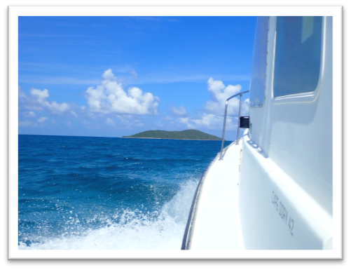
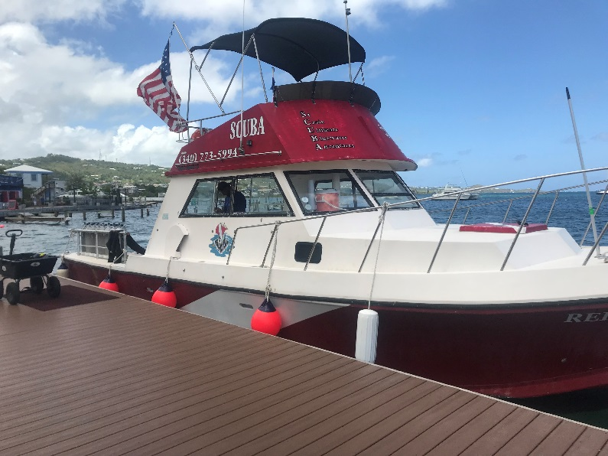
Weekly Schedule
Arrival Day Registration and Orientation
Day Two Swim skill review and scuba skills review
Snorkel BSA
Open Water Dive 1 & 2
Day Three Navigation and Buoyancy skills
Open Water Dives 3 & 4
Day Four PADI Project AWARE
Open Water Dives 5 & 6

Slide 4
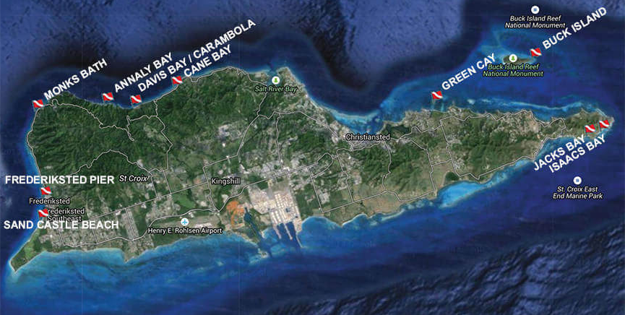
Weekly Schedule (continued)
Day Five Shark Awareness
Open Water Dives 7 & 8
Day Six Open Water Dives 9 & 10
Tour of Ft. Chrisianvaren
Day Seven Departure
Schedule is weather dependent

Slide 5
Skills and Explorations Your Crew Will Accomplish
Compass Navigation Skills Fish Counts
Natural Navigation Skills Coral Bleaching Identification
Advanced Buoyancy Skills Night Diving Skills
Reef Fish and Invertebrate Identification Coral Identification

Slide 6
Certifications and Awards
PADI Project AWARE
S.C.E.N.E.
Duty to God

Slide 7
Sleeping
You will be tent camping
Please bring your own bedding and sleeping pad
Cots are not provided
Normally there is are consistent trade winds blowing from the ocean over camp
Tents have mosquito netting

Slide 8
Galley
All meals served at Camp Wall
Packed lunches for the afternoon
Crews will help prepare and cook dinners
Those with special food needs please
contact us prior to your arrival
FSB.Galley@scouting.org
Sea Base Blessing
Bless the creatures of the Sea Bless this person I call me Bless the Keys you made so grand Bless the sun that warms the land Bless the fellowship we feel as we gather for this meal Amen

Slide 9
Ships Store
Open Everyday
Order Custom Crew Apparel
Shirts
Hats
Duffel Bags
*Custom orders must be placed six weeks prior to arrival
Water bottles, sunscreen and a large
assortment of souvenirs.
www.fsbshipstore.com

Slide 10
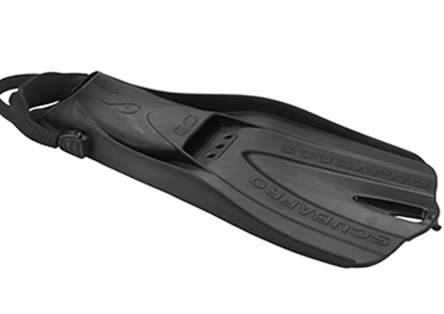
Scuba Equipment
Sea Base is proud to offer ScubaPro equipment
for St. Croix
BC’s with weight integration
Regulators with alternate air sources
3 gauge consoles include pressure gauge, depth gauge and compass
(dive computers not provided or available for rent)
GO Travel fins (no booties required)
Mask and snorkels

Slide 11
Poisonous Plants
Manchineel (Death Apple Tree) is extremely
toxic. Found on and near beaches it has green heart shaped leaves with yellowish veins. Ingestion of the fruit can cause severe burning, blistering, temporary blindness or death.

Slide 12
Poisonous Plants
Comocladia (Christmas Bush) found in open canopies and along trails. Dark green leaves with a reddish hue and possible red fruit. Touching the plant may cause itching, burning, swelling irritation and a rash that may last for several days.

Slide 13
Poisonous Plants
Jumbie Bean (Crab’s Eye or Rosary) is extremely toxic. Found in well drained wooded areas, this vine has bright red seeds. If ingested may cause nausea, vomiting, convulsions, liver failure and death.

Slide 14
Poisonous Plants
Pencil Euphorbia (Milk Bush) is extremely toxic. Bright green pencil thin branches on a shrub like tree that secretes a milky sap when broken or damaged. May cause skin irritation, burns, severe rash and blisters and blindness.

Slide 15
Scuba Medical Document System
All documents that are needed for the Scuba Adventure Programs are to be completed using our online system. Documents must be uploaded onto our online system. We cannot accept documents that have been mailed or emailed.
For all crews this is due no later than March 1st
*As a special note: if you would like to print your completed BSA Medical to take with you for your annual physical, you may do so by selecting “Download Health Form” and printing the PDF once you have completed the questionnaire.

Slide 16
Scuba Medical Document System
Required documents for St. Croix Scuba Adventure:
BSA Parts A, B and C
PADI Medical Statement signed by a medical professional*
PADI Release for Certified Scuba Divers*
Health Insurance Card
Scuba Certification Card
St. Croix Boat Release*
Actions for Addressing Identified Medical Conditions Restriction Diving form**
*These are two page documents and both pages are required to be uploaded
Note**. This may not be required for all divers. Your crew leader will notify you if it will be required.

Slide 17
Here’s how it works:
Once your Primary Adult Crew Leader has registered your unit within the Sea Base Scuba Medical Submission Site, you will receive an email with a link and a request code prompting you to complete your online BSA Medical.
You will not receive this email until your Primary Adult Crew Leader has registered your crew on the medical site.
To create an account (if you are logging in for the first time):
Click the link above to create your account
You will be asked to confirm the information of the participant that has been invited. If this information is correct, select “Continue.”
This will direct you to the log in page. Select ‘Create New Account”
You are creating the account for the parent or guardian NOT the Scout
Follow the prompts on the screen and select “Create.”

Slide 18
To complete your medical (if you are attending Sea Base with your Scout:
Once you have created your account, and have logged in select “Enter Request Code”
Enter the request code that was sent to you by the Primary Adult Crew Leader
Select your name from the drop-down bar or add you name if it does not appear
Once you have selected your name, click “Continue.” You will be directed to begin your medical.
Once you have completed this “Health Form” section, you will have completed your BSA Medical Parts A & B.
To complete a family member/Scout's medical:
Once your account has been created, click "My Account"
Click "My Profile"
Click "Add New Family"-here is where you will add your Scout
Once you have created the Scout's profile be sure to save their information
Click "My Account"
Next, click "Enter a Request Code"-here is where you will enter your Scout's request code
Confirm Scout's information
Proceed to enter the Scout's medical information
Once you have completed this “Health Form” section, you will have completed your BSA Medical Parts A & B.

Slide 19
To manage your “Scuba Participant Uploads:”
Once you have logged in, under “My Account Dashboard” select “View Medicals.”
Click on the name of the participant.
Click “Scuba Participant Uploads.”
Upload the corresponding document to the correct section.
NOTE: Make sure to review the following pages as samples before you upload your required documents. Incomplete or inaccurate documents will be sent back and will delay your processing.
All medical documents must be uploaded onto our online system. We cannot accept documents that have been mailed or emailed.
Please review the Scuba Participant & Parents guide to Online Medicals . The link for this is on our website under each Scuba Adventure

Slide 20
Medical Fitness for Scuba Diving
The following pages are meant to be a guide for the more common conditions and not an absolute list. If you have a medical condition that may be of concern, please contact the Scuba Department at Florida Sea Base for guidance.
The final decision for participation in all Florida Sea Base program is at the discretion of the
Sea Base Medical Director. The decision is final and we are unable to change or alter that decision.
No waivers will be issued.

Slide 21
Absolute medical contradictions for scuba diving with the BSA
Asthma
Epilepsy/Seizures
Insulin dependent diabetes
Multiple (more than one) medication for ADD, ADHD and depression
Anxiety
Narcolepsy
Exceeding the height/weight requirements
NOTE: For additional information read the detailed description on the following slides or in the Participant Guide.
Not every disqualifying medical condition for scuba diving is listed
The final decision for participation in all Florida Sea Base program is at the discretion of the
Sea Base Medical Director. The decision is final and we are unable to change or alter that decision.
No waivers will be issued.

Slide 22
Medical Fitness for Scuba Diving
BSA Annual Health and Medical Record Part C and PADI Medical Statement must be signed
by a physician within the last year. Florida Sea Base must receive this 30 days prior to your arrival.
Medical issues:
Hypertensive: Blood pressure must be lower than 140/90 prior to arrival at Sea Base.
Epilepsy: Participants have been cleared by their physician, they do not take seizure
medications and have not had a seizure within the last 5 years.
Seizure Activity: A person with a history of seizure activity (neurological or other) who
have been asymptomatic and medication free for 5 years may be allowed to
scuba dive.
Concussions: Those who have suffered a concussion should contact Florida Sea Base
The final decision for participation in all Florida Sea Base program is at the discretion of the
Sea Base Medical Director. The decision is final and we are unable to change or alter that decision.
No waivers will be issued.

Slide 23
Medical Fitness for Scuba Diving
Weight Limits:
Sea Base participants must meet the BSA Height and Weight Guidelines. Exceptions may be made for individuals who do not exceed the BSA H&W Guidelines by more than 20lbs. To receive an exception, the participant must provide a letter from their physician (MD or DO only) stating that they are in good health and are approved for participation.
1. If they are under the height/weight limit they are fine.
2. If they are over the height/weight limit by no more than 20 pounds, a note from the physician will work.
3. If they are over the height/weight limit by more than 20 pounds they will not be allowed to attend.
4. Individuals 78 inches or taller cannot be offered an exception.
Any participant not meeting the height/weight requirements will be sent home at their own expense. Absolutely no exceptions will be made.
The final decision for participation in all Florida Sea Base program is at the discretion of the
Sea Base Medical Director. The decision is final and we are unable to change or alter that decision.
No waivers will be issued.

Slide 24
Medical Fitness for Scuba Diving
Medical issues:
ADD/ADHD/depression Medication: Your physician must contact Divers Alert Network
for a consultation before signing Part C*. Participants on multiple (more than one)
medication will not be cleared to scuba dive.
Anxiety Medication: Participants with anxiety will not be cleared to scuba dive.
*Physician (MD or DO only) must complete the Actions for Addressing Identified Medical
Conditions Restricting Diving form and submit it with the participants other documents.
Concussions: Those who have suffered a concussion should contact Florida Sea Base
The final decision for participation in all Florida Sea Base program is at the discretion of the
Sea Base Medical Director. The decision is final and we are unable to change or alter that decision.
No waivers will be issued.

Slide 25
Medical Fitness for Scuba Diving
Medical issues:
Asthma:
Persons being treated for asthma (including reactive airway disease) are disqualified from BSA scuba programs. Persons with a history of asthma who have been asymptomatic and have not used medications to control asthma for five years or more may be allowed to scuba dive as part of a BSA activity upon submission of evidence from their treating physician. Persons with a history of asthma who have been asymptomatic and have not used medication to control asthma for fewer than five years may be allowed to scuba dive as part of a BSA activity upon submission of a methacholine challenge test showing the asthma to be resolved to the satisfaction of the Sea Base Medical Director. This is the only test approved by the BSA.
∗∗∗Asthma Information∗∗∗
Participants, youth or adult, with asthma will not be cleared to scuba dive. The predisposing factors, severity of attacks or intermitted asthma does not change this BSA policy. Those that are currently scuba certified or have a physician’s approval for scuba diving will not be cleared to scuba dive at Florida Sea Base. There are no exceptions, exclusions or waivers to this policy.
The final decision for participation in all Florida Sea Base program is at the discretion of the
Sea Base Medical Director. The decision is final and we are unable to change or alter that decision.
No waivers will be issued.

Slide 26
Medical Fitness for Scuba Diving
Medical issues:
Diabetes:
Persons 18 years old or older must submit four hemoglobin A1c test with each test being less than 7, which are taken with in the last 12 months. Any test higher than 7 will disqualify a participant. Persons younger that 18 years of age with Type 1 diabetes will not be allowed to scuba dive. Participants who use insulin to control diabetes will not be qualified to scuba dive.
∗∗∗Diabetes Information∗∗∗
Participants that are insulin dependent, youth or adult, will not be cleared to scuba dive. Those that are currently scuba certified or have a physician’s approval for scuba diving will not be cleared to scuba dive at Florida Sea Base. Participants younger than 18 years of age with Type 1 diabetes will not be cleared to scuba dive. There are no exceptions, exclusions or waivers to this policy.
∗∗∗
The final decision for participation in all Florida Sea Base program is at the discretion of the
Sea Base Medical Director. The decision is final and we are unable to change or alter that decision.
No waivers will be issued.

Slide 27
Crew Leader Information
Administration
Crew Rosters completed 90 days prior to arrival
Medicals in on time to avoid disappointments
All adult leaders must be registered with the BSA
At least one adult leader must have a Wilderness First Aid and CPR certification
All adult leaders must have up to date:
Youth Protection Training
BSA Safe Swim Defense
BSA Safety Afloat
BSA Hazardous Weather Training

Slide 28
FAQ’s
What Scuba Certification cards does BSA-FSB Recognized?
The Boy Scouts of America and Florida Se Base only accept certification from RSTC
recognized training agencies which include IDEA, NASDS, PADI, PDIC, SSI, YMCA
NAUI, SDI/TDI, RAID, IANTD, NASE and SNSI and others listed on the Recreational Scuba Training Council.
No other certification cards are accepted.
May I bring my own scuba equipment?
Yes, but it will be inspected by our professional staff. If it does not meet our
requirements you will have to use our equipment. Do not bring dive knives or spear guns.

Slide 29
FAQ’s
FAQ’s
What if I arrive at Florida Sea Base and I exceed the weight limit?
You will not be permitted to participate in a program or stay at Florida Sea Base. All
must meet the Height/Weight Restrictions found on the BSA Part C Physical.
What if I arrive without a signed medical?
All medical documentation must be taken care of in advance and signed by a physician.
You will not be permitted to participate in a program or stay at Florida Sea Base.
If I am unable to scuba dive may I participate as a snorkeler?
Yes.

Slide 30
FAQ’s
Recommendations on What to Bring
1 Long sleeve shirt • Water bottle
1 Short sleeve shirt • 1 Sleeping cover
Wide brimmed hat • Polarized sunglasses
Dive logbook • 2 towels
Biodegradable sunscreen • Dive watch
2 pair of shorts (1 swim trunks, 1 regular) • Toiletry kit
Light pants • Flashlight
3 Pairs of socks (1 being neoprene swim socks) • Camera
2 Pairs of shoes (1 athletic, 1 sandals) • Insect repellent
Light rain jacket • Spending money ($150-$200)
Sleeping pad

Slide 31
FAQ’s
What NOT to Bring
Spear Guns • Personal music player
Firearms • Mess kits
Fireworks • Metal or aluminum water bottles
Skateboards • Unnecessary items
Aerosol sunscreen or bug spray

Slide 32
Contact Details
Florida Sea Base Main phone 305-664-4173
FAX 305-664-2039
Scuba Director – Joe Angelo 305-394-5480
joe.angelo@scouting.org
Program Office Manager-Natacha Angelo305-664-5627
natacha.angelo2@scouting.org
Registration Information – Nancy Wells 305-664-5616
nancy.wells@scouting.org
Director of Program Operations – Tim Stanfill 305-664-5614
tim.Stanfill@scouting.org

