Slide 1
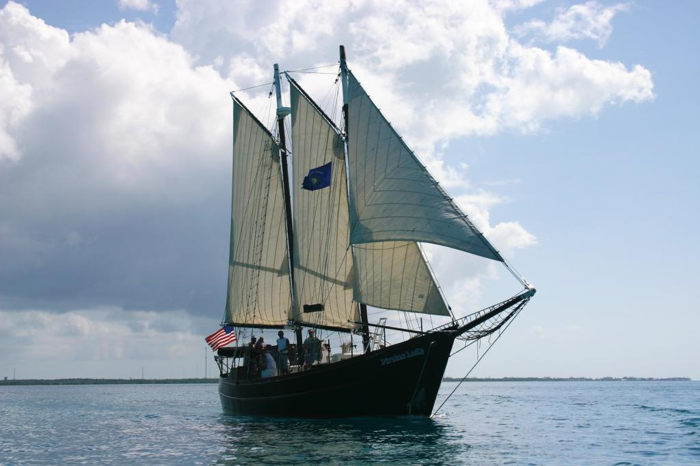
SCUBA Live Aboard

Slide 2
Brief History of Florida Sea Base
The Sea Base began in the early 1970's as a local program in the Florida Keys called the Florida Gateway to High Adventure under the guidance of Sam Wampler, a professional Scouter from the South Florida Council. It offered primarily sailing programs using local marinas and chartered boats sailing to the Bahamas and back. As the idea caught on and grew, it joined the high adventure offerings of the National Council of the BSA along with Philmont Scout Ranch and the Northern Tier High Adventure Base. In 1979 the Sea Base acquired a permanent facility on Lower Matecumbe Key and when this opened for Scouts in 1980 it was renamed the Florida National High Adventure Sea Base. As the popularity of this program grew, scuba diving was added and in 1984 the BSA received the gift of Big Munson Island from Homer Formsby. This undeveloped island offered tremendous program potential as an outpost for primitive camping, Robinson Crusoe style. During this time period the sailing program concentrated on sailing around the fabulous Florida Keys. New sailing programs were started that originated and ended in Marsh Harbour in the beautiful Abaco Islands of the Bahamas.

Slide 3
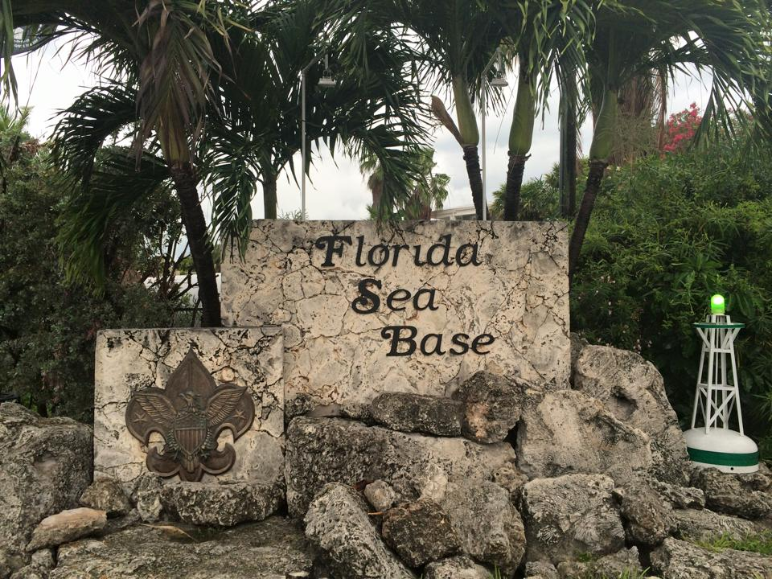
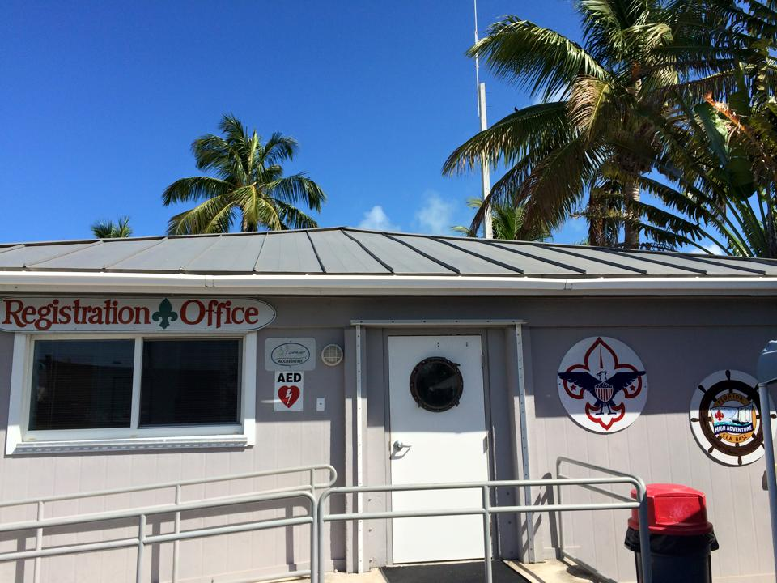
Arrival and Registration
Arrival Time is between 1 and 3 PM
Check in and review documents
Meet your Professional Sea Base Divemaster
Check into Scuba Dorms
Crew Photos taken
Issue Equipment
Scuba Review
Swim Review

Slide 4
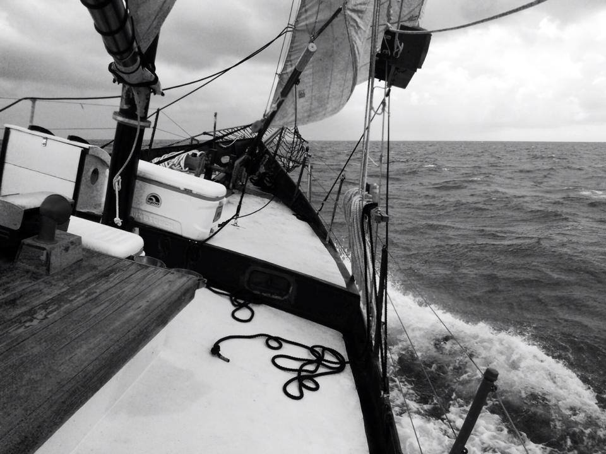
Weekly Schedule
Arrival Day Registration, swim test and scuba skills review
Orientation
Day Two Scuba Review make up/
Pack all equipment for the boat
Provision boat
Depart Florida Sea Base for the boat
Day Three -Six Open Water Dives and snorkeling
Day Seven- Last dive, clean boat depart for Sea Base
Luau
Day Eight Departure
Schedule is weather dependent

Slide 5
Skills and Explorations Your Crew Will Accomplish
Compass Navigation Skills Fish Counts
Natural Navigation Skills Coral Bleaching Identification
Advanced Buoyancy Skills Night Diving Skills
Reef Fish and Invertebrate Identification Coral Identification

Slide 6
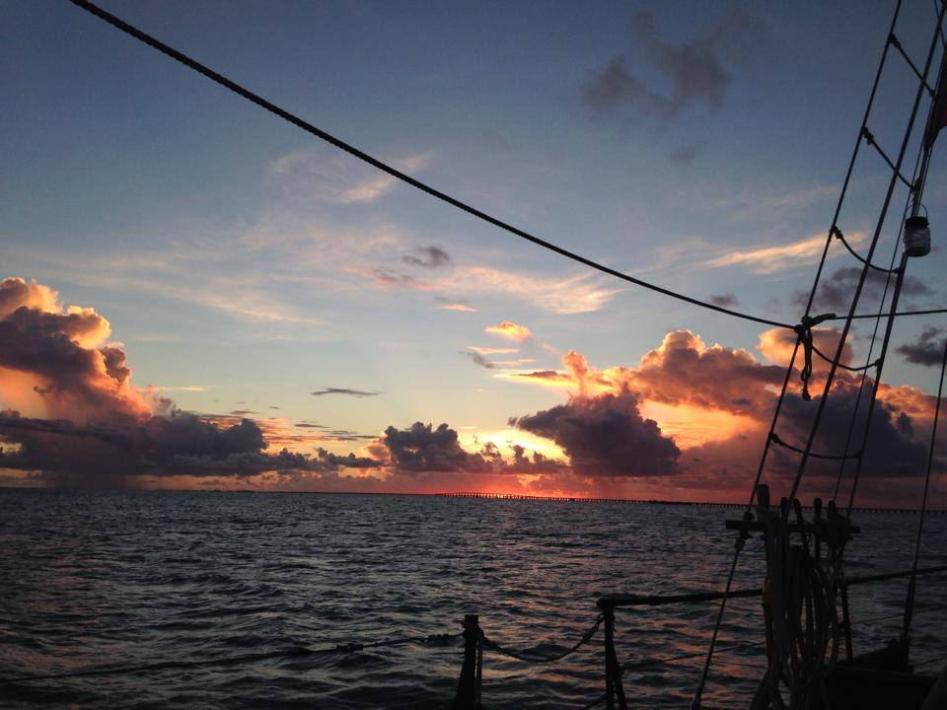
Certifications and Awards
PADI Project AWARE Coral Reef Conservation Certification
S.C.E.N.E.
Duty to God

Slide 7
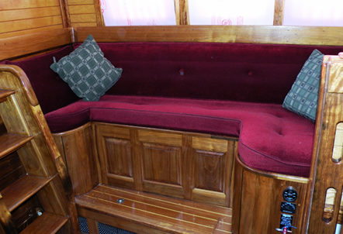
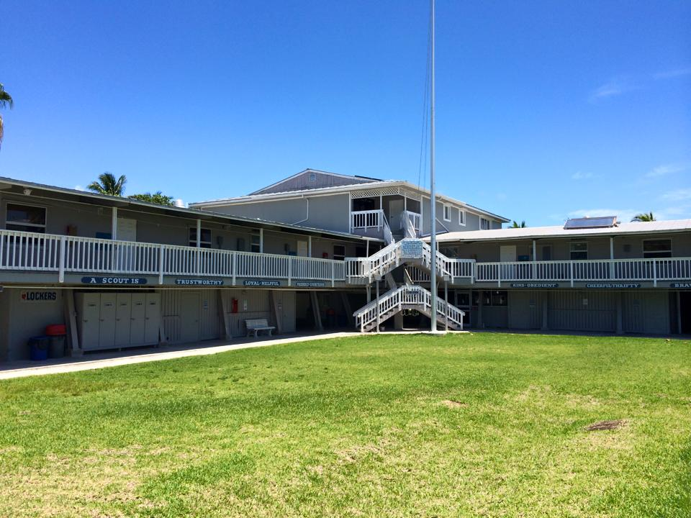
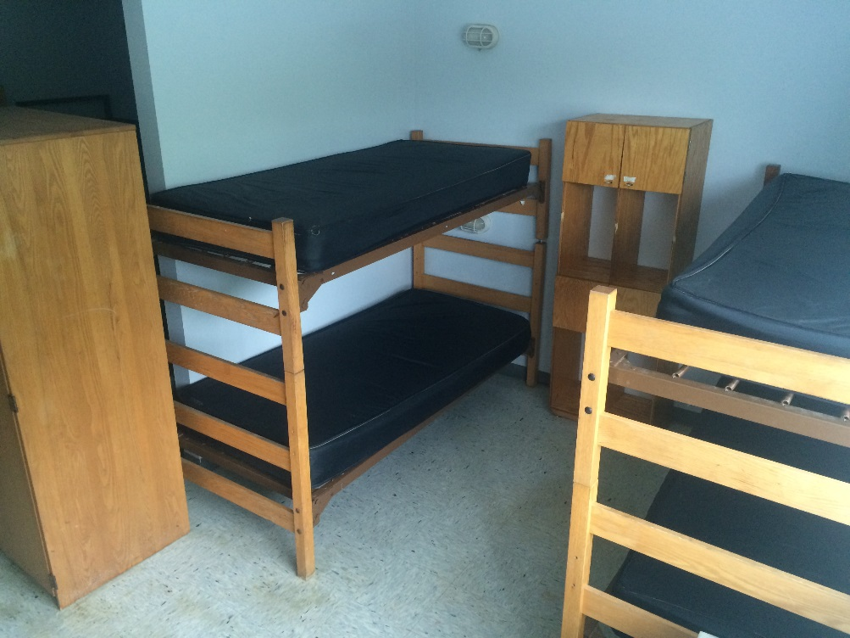
Dorm
Dorms are provided for you first and last night of your adventure
Please bring your own bedding, mattresses are provided
Separate dorm rooms for women
All rooms are air conditioned

Slide 8
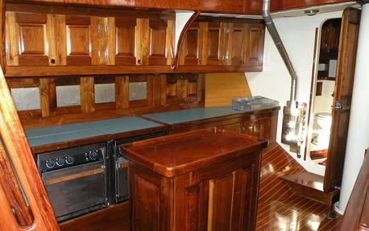
Galley
First and last day meals served at the galley
All other meals prepared by you while on the boat
Those with special food needs please
contact us prior to your arrival
FSB.Galley@scouting.org
Sea Base Blessing
Bless the creatures of the Sea Bless this person I call me Bless the Keys you made so grand Bless the sun that warms the land Bless the fellowship we feel as we gather for this meal Amen

Slide 9
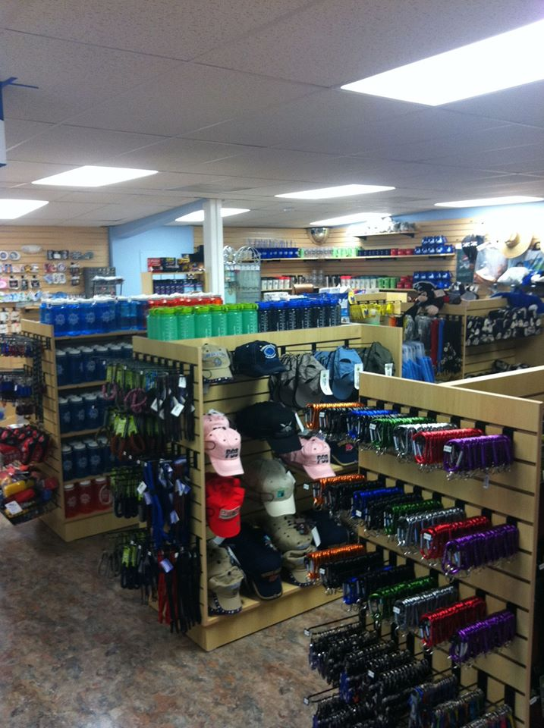
Ships Store
Open Everyday during season
Order Custom Crew Apparel
Shirts
Hats
Duffel Bags
*Custom orders must be placed six weeks prior to arrival
Reserve wetsuits
Water bottles, sunscreen and a large
assortment of souvenirs.
www.fsbshipstore.com

Slide 10
Scuba Equipment
Florida Sea Base is proud to offer Aqualung equipment
as our exclusive scuba equipment provider
Wave BC’s with weight integration
Calypso Regulators with alternate air sources
3 gauge consoles include pressure gauge, depth gauge and compass
(dive computers not provided or available for rent)
Full wetsuits available for rent (only needed for winter and spring programs)
Hotshot fins (no booties required)
Dive light provided for night dives

Slide 11
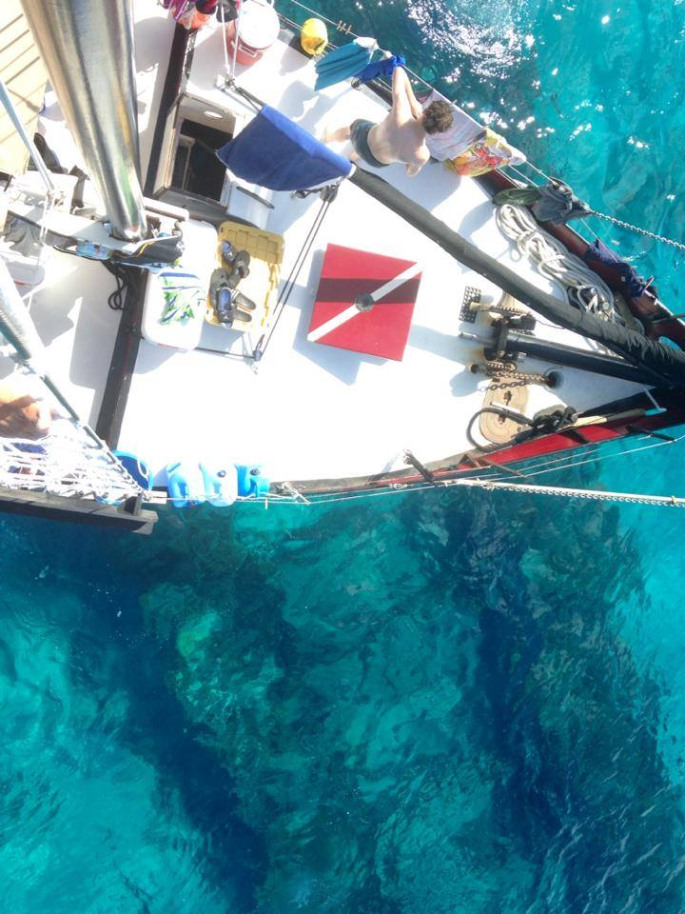
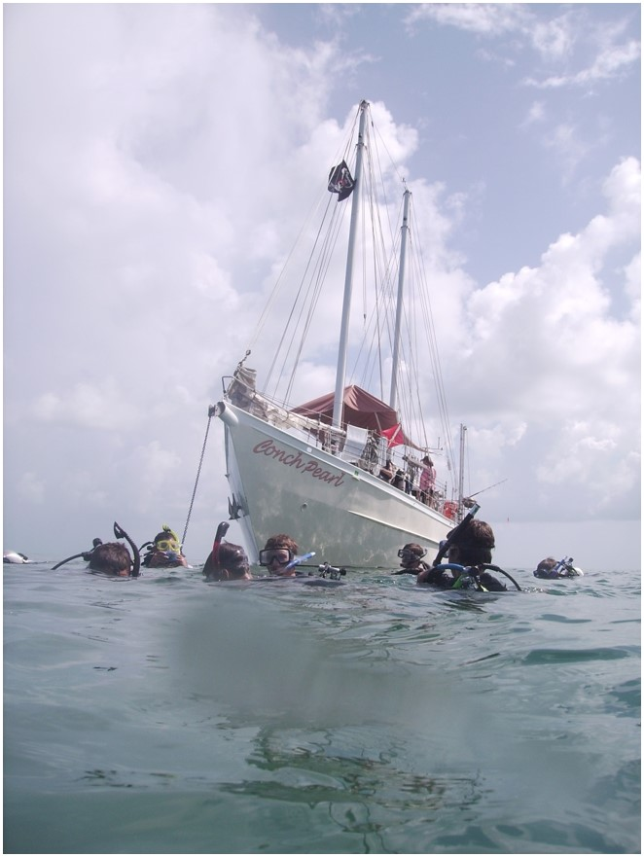
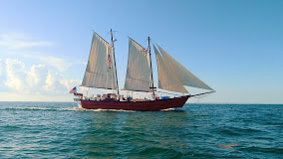
Live Aboard Fleet
Conch Pearl-Steel hull Schooner
Pirates Lady-Steel Hull Schooner
Sea Eagle-Morgan and Missty-Shark Boat
All boats have Oxygen, AED’s, underwater recall systems, First Aid Kits, Marine Head, and VHF Radios.

Slide 12
Required Paperwork
BSA Documents
Part A Informed Consent, Release Agreement, and Authorization
Part B General Information/Health History (2 pages)
Part C Pre-Participation Physical – Signed by a physician
PADI Forms
Release for Certified Divers
• PADI Medical Statement signed by a Physician (MD or DO only)
All forms are available on the Florida Sea Base website under “Resources”

Slide 13
Important Dates
Spring Crews – BSA Annual Health and Medical Record Parts A & B by January 1st
Summer Crews - BSA Annual Health and Medical Record Parts A & B by March 1st
Winter Crews - BSA Annual Health and Medical Record Parts A & B by October 1st
30 days prior to arrival : Medical Record Part C signed by physician
PADI Release for Certified Divers
PADI Medical Statement signed by physician (MD or DO only)
Copy of health insurance card
Copy of scuba certification card
Please include your Crew Number on all correspondence.

Slide 14
Medical Fitness for Scuba Diving
The following pages are meant to be a guide for the more common conditions and not an
absolute list. If you have a medical condition that may be of concern, please contact the Scuba Department at Florida Sea Base for guidance.
The final decision for participation in all Florida Sea Base program is at the discretion of the
Sea Base Medical Director. The decision is final and we are unable to change or alter that decision.
No wavers will be issued.

Slide 15
Medical Fitness for Scuba Diving
BSA Annual Health and Medical Record Part C and PADI Medical Statement must be signed
by a physician within the last year. Florida Sea Base must receive this 30 days prior to your arrival.
Medical issues:
Hypertensive: Blood pressure must be lower than 140/90 prior to arrival at Sea Base.
Epilepsy: Participants have been cleared by their physician, they do not take seizure
medications and have not had a seizure with in the last 5 years.
Seizure Activity: A person with a history of seizure activity (neurological or other) who
have been asymptomatic and medication free for 5 years may be allowed to
scuba dive.
The final decision for participation in all Florida Sea Base program is at the discretion of the
Sea Base Medical Director. The decision is final and we are unable to change or alter that decision.
No wavers will be issued.

Slide 16
Medical Fitness for Scuba Diving
Medical issues:
Weight Limits: Weight limit guidelines (see Part C of the BSA Health and Medical Record) are used because individuals outside of these guidelines are at a greater risk for heart disease, stroke, injury and death. These guidelines are for all Scouting high adventure activities. Participants who exceed the weight limit of 295 lbs., as evidenced by their BSA Health and Medical Record, will not be allowed to participate in a Sea Base Adventure and will be sent home at their own expense. Due to rescue equipment restrictions and evacuation efforts from remote sites, under no circumstances will any individual exceeding 295 lbs. be permitted to participate. Anyone arriving at Sea Base exceeding 295 lbs. will be sent home. No refund will be given.
The final decision for participation in all Florida Sea Base program is at the discretion of the
Sea Base Medical Director. The decision is final and we are unable to change or alter that decision.
No wavers will be issued.

Slide 17
Medical Fitness for Scuba Diving
Medical issues:
ADD/ADHD Medication: Your physician must contact Divers Alert Network
for a consultation before signing Part C. *
Anti-Depressant/Anxiety Medication: Your physician must contact Divers Alert Network
for a consultation before signing Part C. Particular attention is paid to anxiety
medications and the effect anxiety may have on the scuba diver.*
*Physician (MD or DO only) must complete the Information Regarding Medical Restrictions
form and submit it with the participants other documents.
Concussions: Those who have suffered a concussion should contact Florida Sea Base
The final decision for participation in all Florida Sea Base program is at the discretion of the
Sea Base Medical Director. The decision is final and we are unable to change or alter that decision.
No wavers will be issued.

Slide 18
Medical Fitness for Scuba Diving
Medical issues:
Asthma:
Persons being treated for asthma (including reactive airway disease) are disqualified from BSA scuba programs. Persons with a
history of asthma who have been asymptomatic and have not used medications to control asthma for five years or more may
be allowed to scuba dive as part of a BSA activity upon submission of evidence from their treating physician. Persons with a
history of asthma who have been asymptomatic and have not used medication to control asthma for fewer than five years
may be allowed to scuba dive as part of a BSA activity upon submission of a methacholine challenge test showing the asthma
to be resolved to the satisfaction of the Sea Base Medical Director. This is the only test approved by the BSA.
Those with asthma no matter the severity, causes or intermitted asthma will not be qualified to scuba dive.
The final decision for participation in all Florida Sea Base program is at the discretion of the
Sea Base Medical Director. The decision is final and we are unable to change or alter that decision.
No wavers will be issued.

Slide 19
Medical Fitness for Scuba Diving
Medical issues:
Diabetes:
Persons 18 years old or older must submit four hemoglobin A1c test with each test being less
than 7, which are taken with in the last 12 months. Any test higher than 7 will disqualify a
participant. Persons younger that 18 years of age with Type 1 diabetes will not be allowed to
scuba dive. Participants who use insulin to control diabetes will not be qualified to scuba dive.
The final decision for participation in all Florida Sea Base program is at the discretion of the
Sea Base Medical Director. The decision is final and we are unable to change or alter that decision.
No wavers will be issued.

Slide 20
Crew Leader Information
Administration
Crew Rosters completed 90 days prior to arrival
Medicals in on time to avoid disappointments
All adult leaders must be registered with the BSA
At least one adult leader must have a Wilderness First Aid and CPR certification
All adult leaders must have up to date:
Youth Protection Training
BSA Safe Swim Defense
BSA Safety Afloat
This is Scouting (optional)

Slide 21
FAQ’s
What Scuba Certification cards does BSA-FSB Recognized?
The Boy Scouts of America and Florida Se Base only accept certification from RSTC
recognized training agencies which include IDEA, NASDS, PADI, PDIC, SSI, YMCA
and NAUI. No other certification cards are accepted.
May I bring my own scuba equipment?
Yes, but it will be inspected by our professional staff. If it does not meet our
requirements you will have to use our equipment. Do not bring dive knives or spear guns.
Are prescription masks available?
Yes, prescription masks are available in diopters from -1.0 to -8.0 in whole diopters
You may dive in contacts if you wear them.
Are Wet suits provided?
Weekly rentals are available through the Ships Store. They are not needed during the summer.

Slide 22
FAQ’s
FAQ’s
What if I arrive at Florida Sea Base and I exceed the weight limit of 295 pounds?
You will not be permitted to participate in a program or stay at Florida Sea Base. All
must meet the Height/Weight Restrictions found on the BSA Part C Physical.
What if I arrive with out a signed medical?
All medical documentation must be taken care of in advance and signed by a physician.
You will not be permitted to participate in a program or stay at Florida Sea Base.
If I am unable to scuba dive may I participate as a snorkeler?
Yes.

Slide 23
FAQ’s
Are we allowed to fish while on board?
Yes, Fishing poles and gear will be provided. The boat has a fishing license that will
cover everyone.
Are we able to catch lobster?
Using snorkeling equipment only and as long as they are in season.
Will we have any breaks from the boat?
There is one mid-week break. The boat will pull into port and you will have an
opportunity to get off, have a shower and sleep on board with some air conditioning.

Slide 24
FAQ’s
How much room do I have for clothing?
All your item (except bedding and scuba equipment) must fit into a 24 inch duffel bag
provided by Sea Base.
Where will we sleep while aboard the boat?
Most participants choose to sleep on deck, but bunks are available. Please bring a
pad incase you choose to sleep on deck. There is not enough room for hammocks.
What duties will we have while on board?
Preparing meals, cleaning the boat, raising and lowering sails, anchor watch and
other duties assigned by the captain.

Slide 25
FAQ’s
Recommendations on What to Bring
1 Long sleeve shirt • Water bottle
1 Short sleeve shirt • 1 Sleeping cover
Wide brimmed hat • Lightweight sleeping pad
Polarized sunglasses • 2 towels
Biodegradable sunscreen • Dive watch
2 pair of shorts (1 swim trunks, 1 regular) • Toiletry kit
Light pants • Flashlight
3 Pairs of socks (1 being neoprene swim socks) • Camera
2 Pairs of shoes (1 athletic, 1 sandals) • Insect repellent
Light rain jacket • Dive logbook and certification card
Spending money ($100-$150)

Slide 26
FAQ’s
What NOT to Bring
Spear Guns • Personal music player
Firearms • Mess kits
Fireworks • Metal or aluminum water bottles
Skateboards • Unnecessary items
Aerosol sunscreen or bug spray • Hammock
Deck shoes

Slide 27
Contact Details
Florida Sea Base Main phone 305-664-4173
FAX 305-664-2039
Scuba Director – Joe Angelo 305-394-5480
joe.angelo@scouting.org
Program Office Manager-Lindsey Smith 305-664-5627
lindsey.smith@scouting.org
Registration Information – Nancy Wells 305-664-5616
nancy.wells@scouting.org
Director of Program Operations – Tim Stanfill 305-664-5614
tim.Stanfill@scouting.org

